Slide 1
Review of “ A Study of an Electromagnetic Energy Harvester Using Multi-Pole Magnet “

Slide 2
Low power wireless sensor networks need their own power supply in order to deal with interconnection, electronics noise and control system complexity. There are some sources of power like batterys but they are unreliable and often require maintenance. That is why harvesting energy from the environment is more suitable solution.
The different vibration-based energy harvesters available are :
Piezoelectric ( needs High resonant frequency)
Electrostatic or triboelectric ( need isolated voltage sources )
Electromagnetic ( low resonant frequency so ideal to harvest from frequency available form the environment )

Slide 3
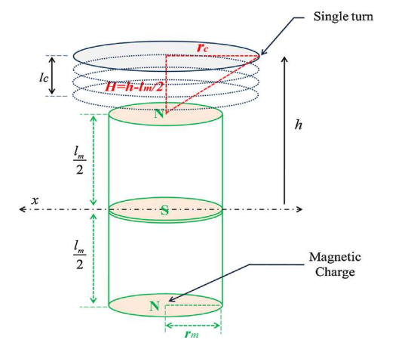



So we will now focus on Electromagnetic harvesters. In this paper multipole Electromagnetic harvester is proposed. We know that all the magnetic flux contributions which follows the Maxwell’s Equations can be superimposed. Hence we get the following flux equation:
From the above flux equation we can derive the induced emf by faraday’s law:
Here v is the velocity of vibration defined as

Slide 4
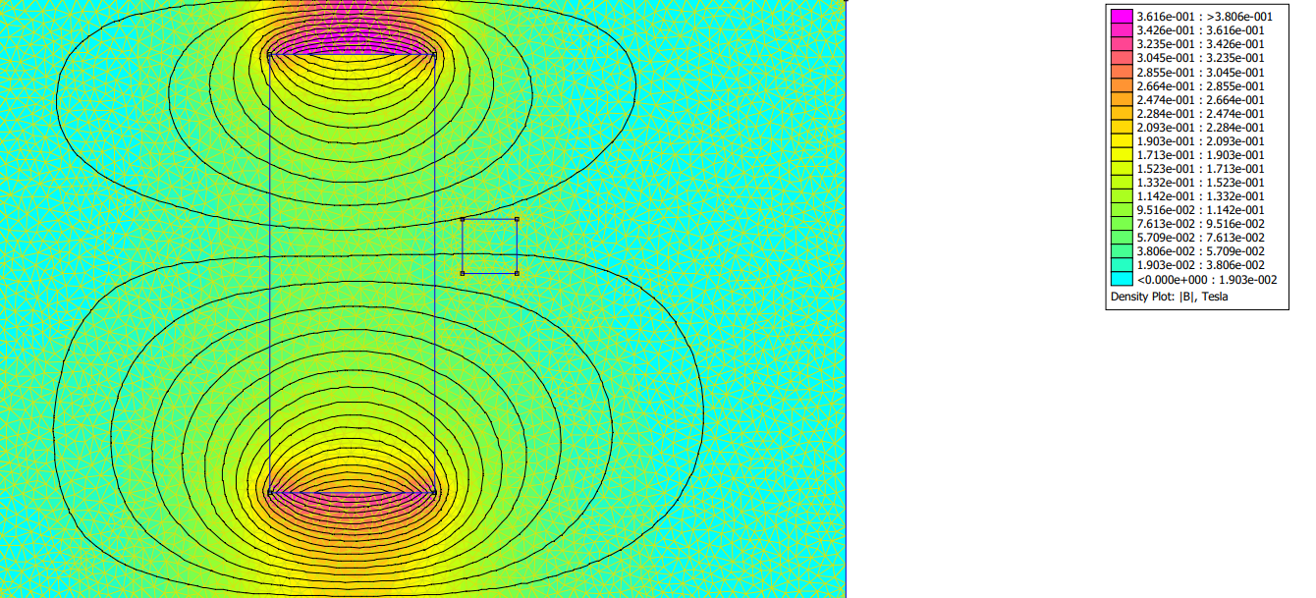
I simulated for the various cases of multipole magnets. The paper used Ansys software, I used a software called FEMM 4.2
Here are the observations:
For a single pole magnet :

Slide 5
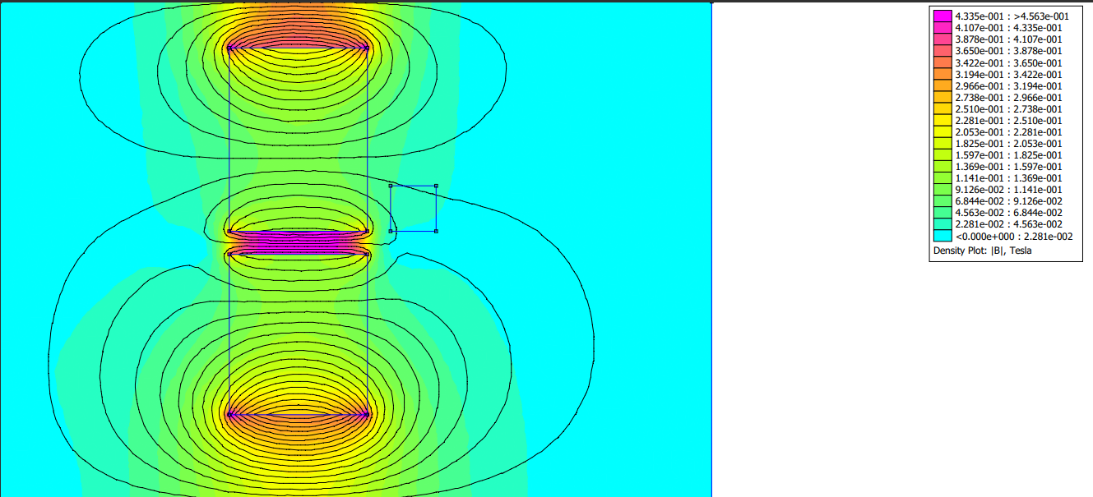
For a double pole magnet :

Slide 6
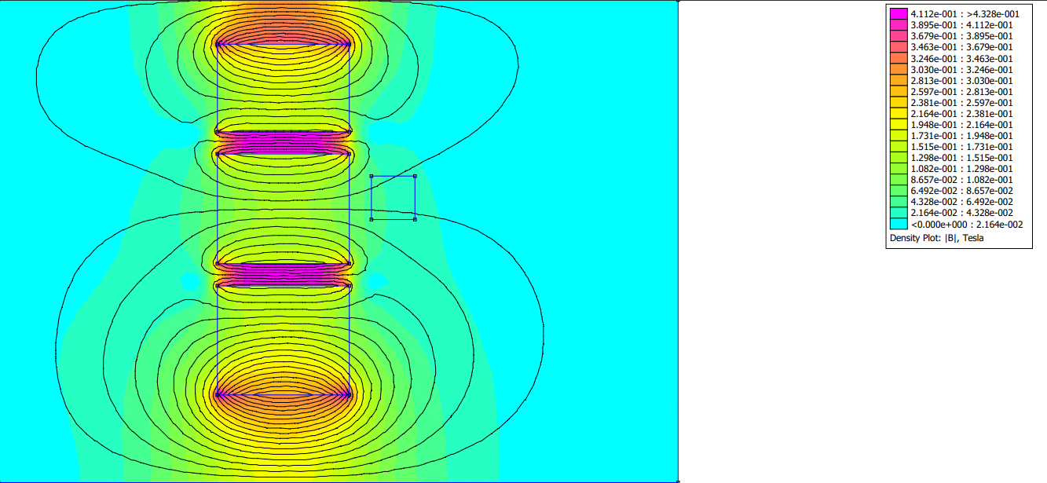
For a triple pole magnet :

Slide 7
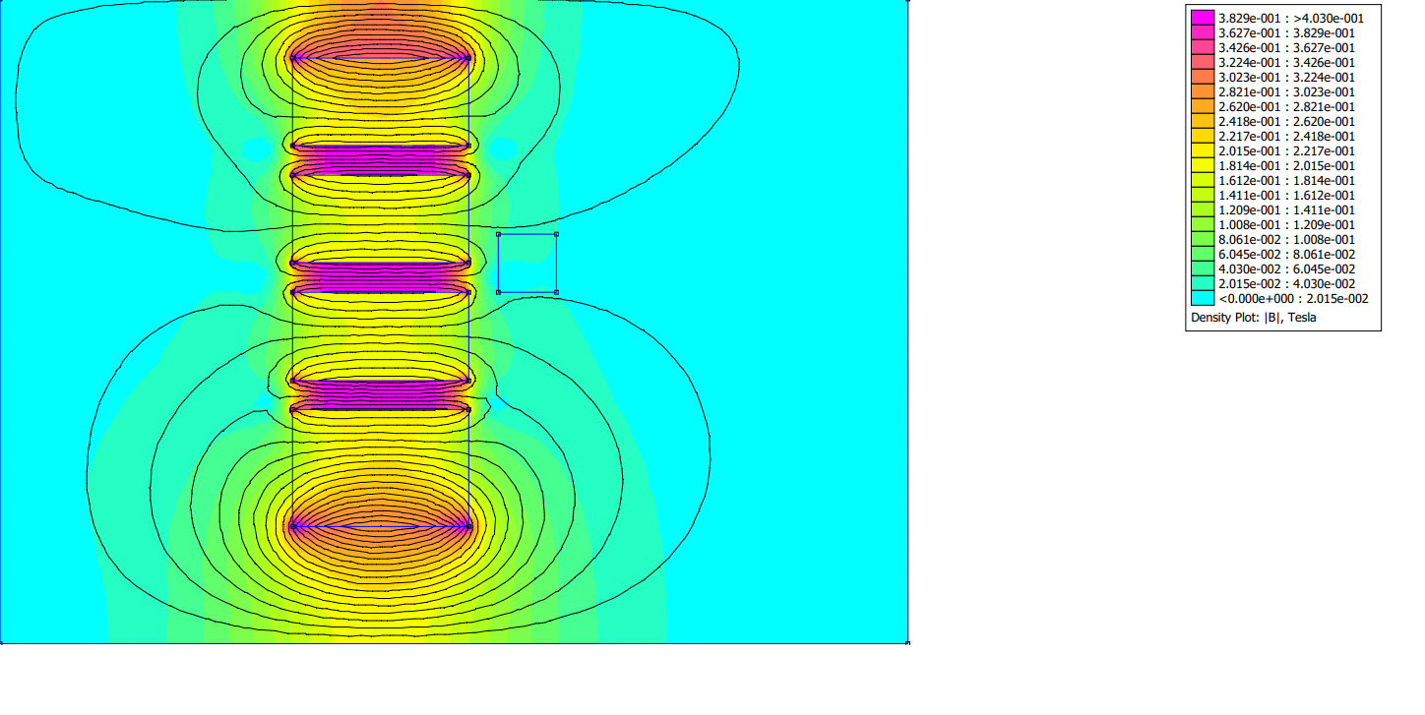
For a quad pole magnet :

Slide 8
Conclusion from FEMM 4.2 Simulations
We get the most flux linkage when number of poles = 3 .
After triple pole magnets the flux lines becomes so much squished that the voltage generated drops drastically when compared with Triple poled magnet one.

Slide 9
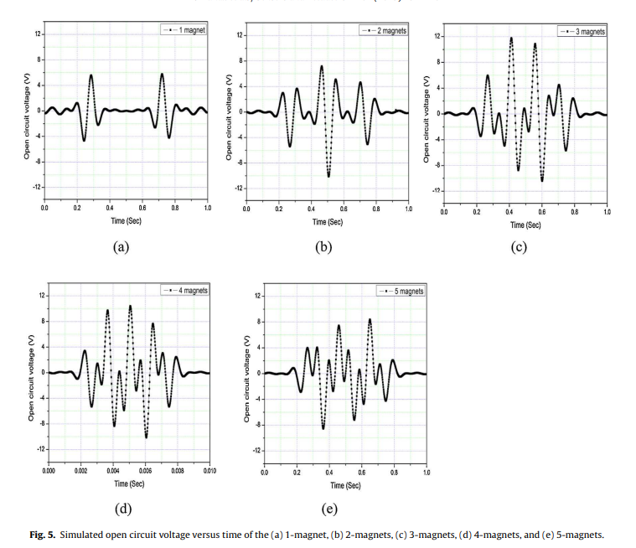
Comparison of the open circuit voltages for 1, 2, 3, 4, and 5 magnet arrangements

Slide 10
Conclusion
The optimized harvester with 3 magnets produces a maximum 4.84 mW of power with a load resistance of 1.0 k. It also has a very low resonance frequency of about 6 Hz which is also very much convenient for human wearable and wireless sensor node applications.

